Slide 1

Apache Kafka

Slide 2
Need of Messaging System

Slide 3
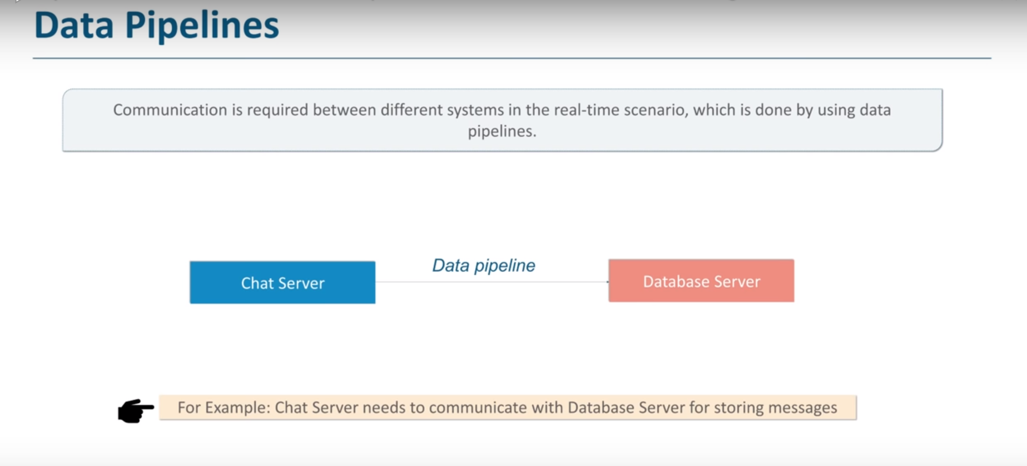

Slide 4
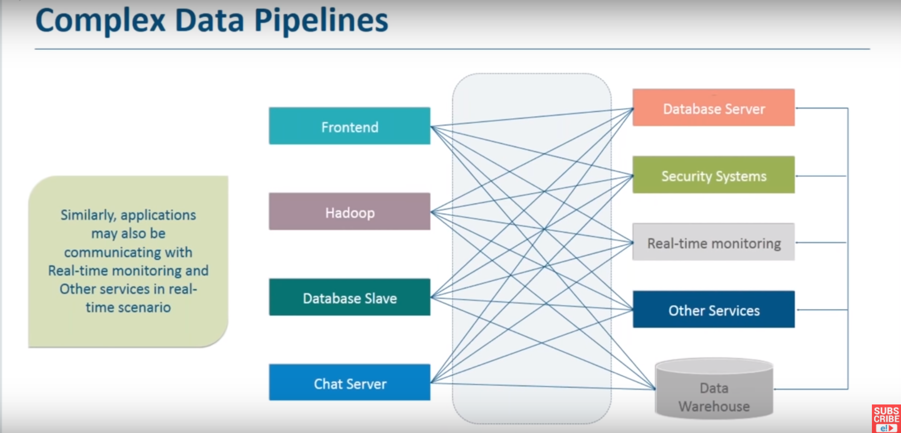

Slide 5
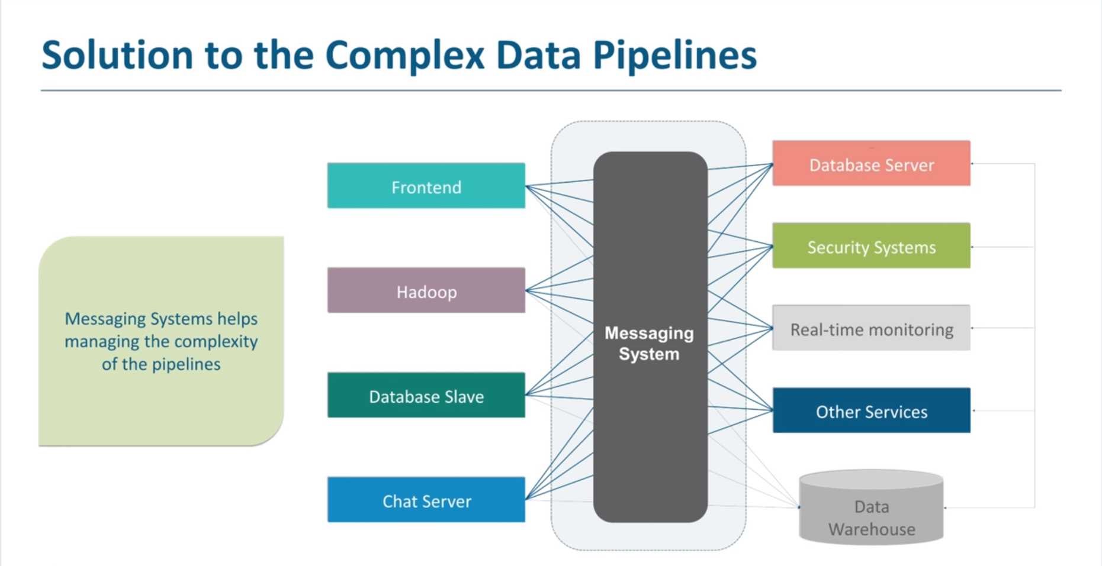

Slide 6
Let’s See How Kafka Solves the Problem

Slide 7
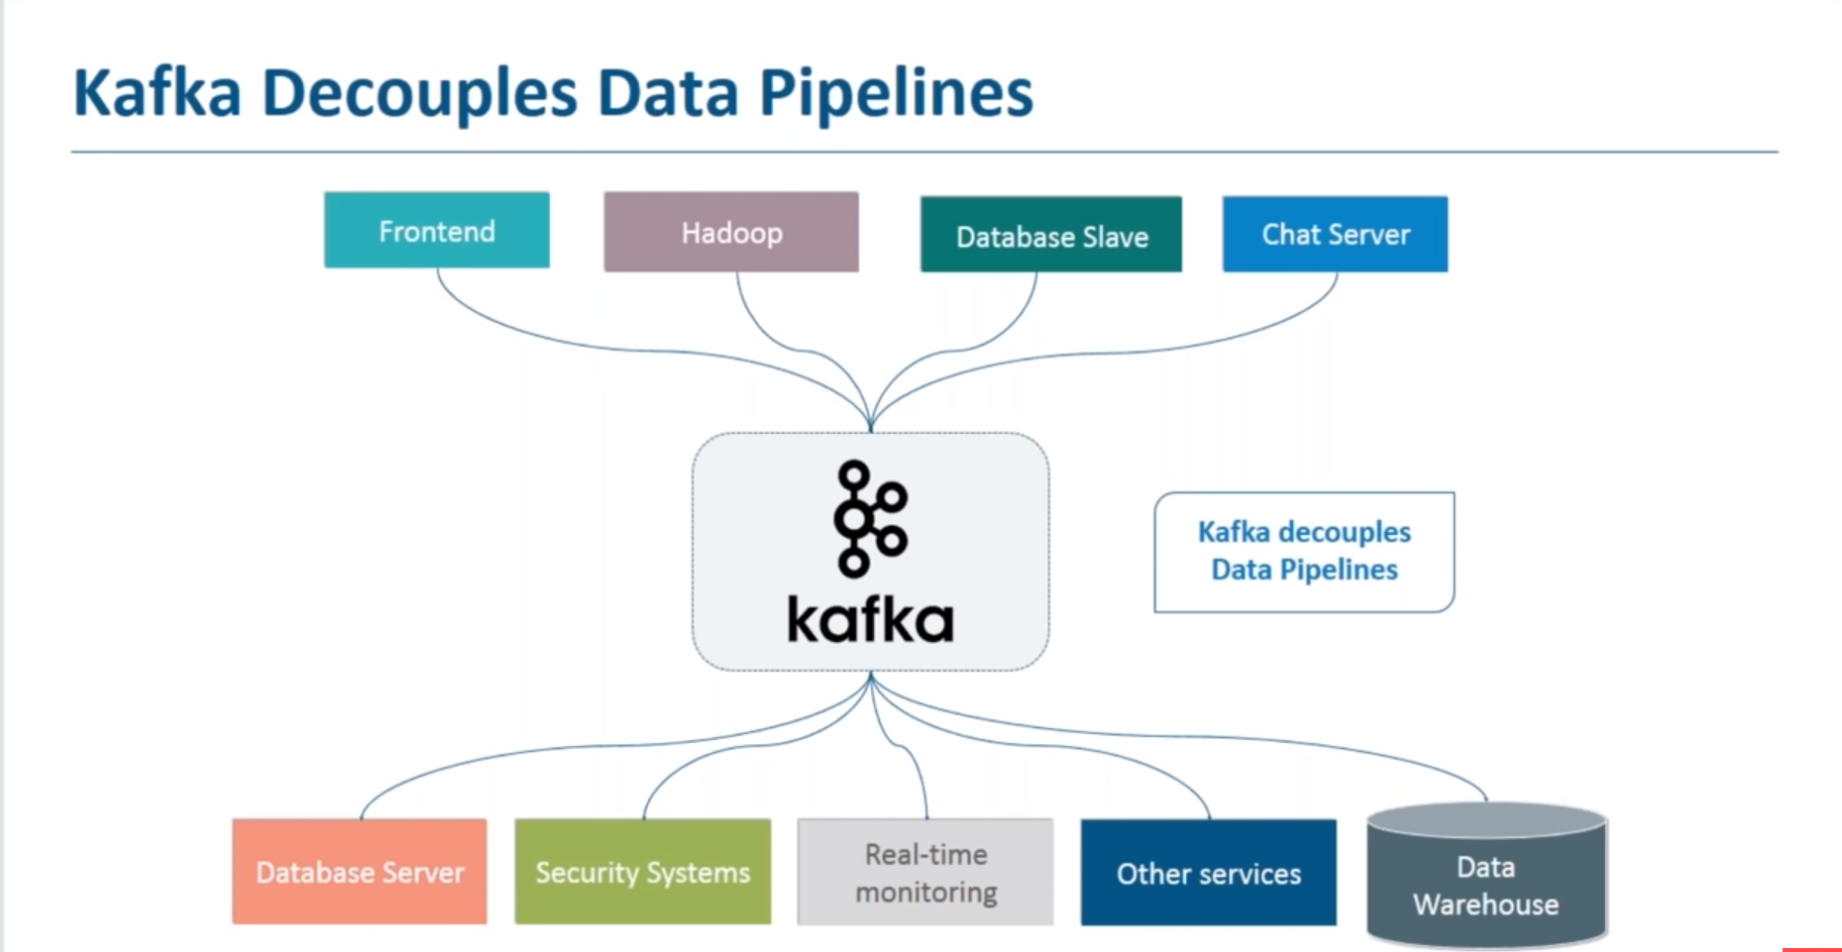

Slide 8

What Is Apache Kafka
Apache Kafka is a distributed publish-subscribe messaging system.
Kafka is fast, scalable, durable, fault-tolerant and distributed by design.

Slide 9
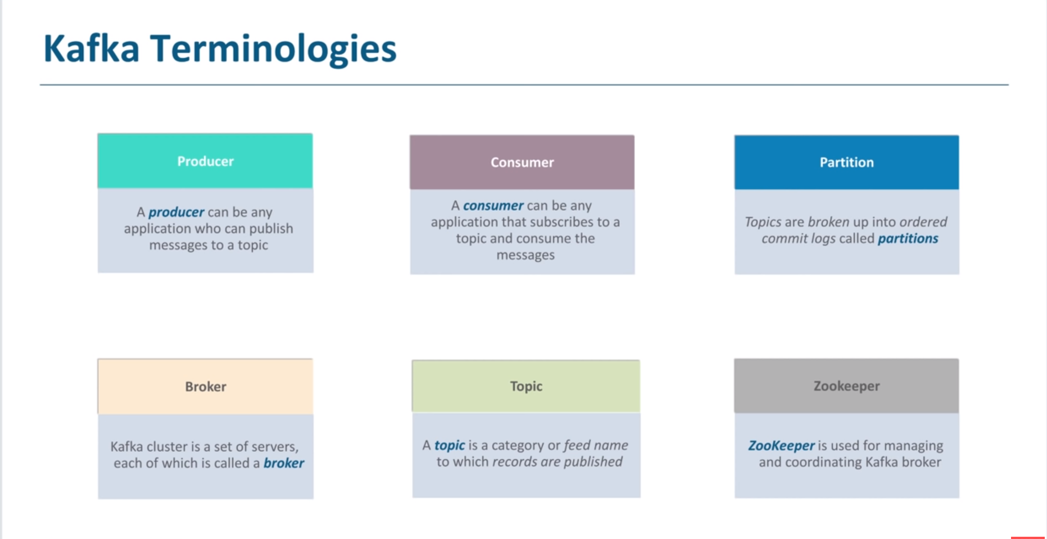

Slide 10
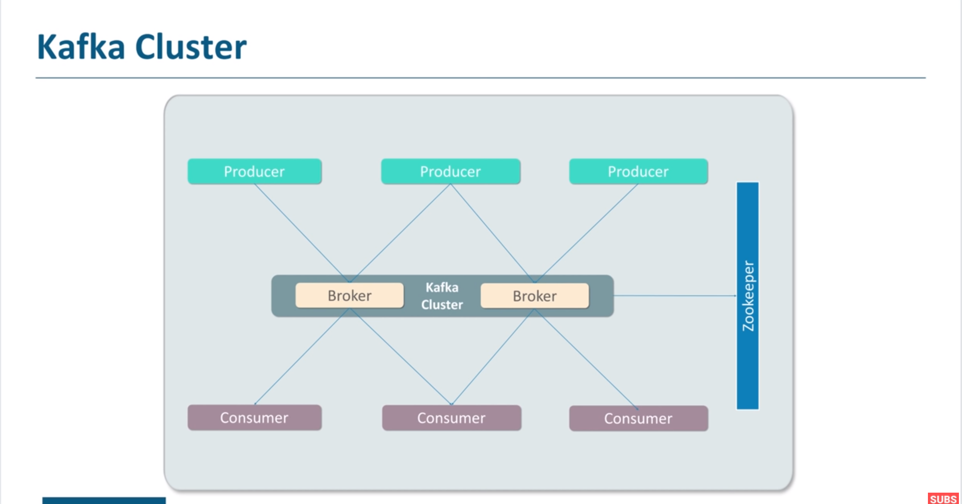

Slide 11
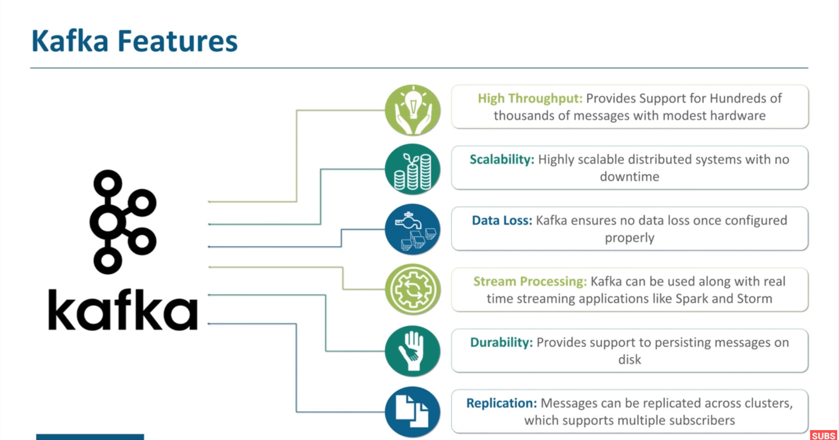

Slide 12
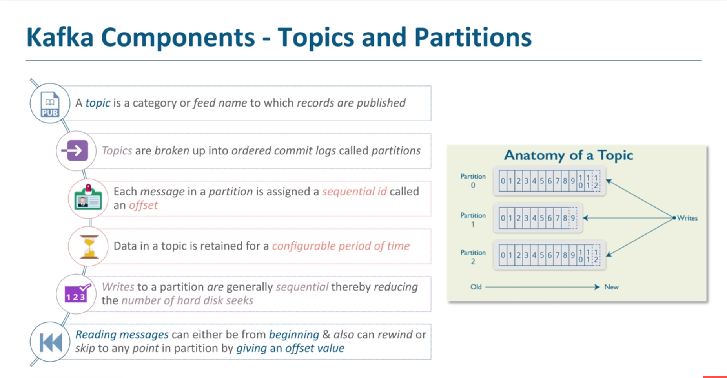

Slide 13
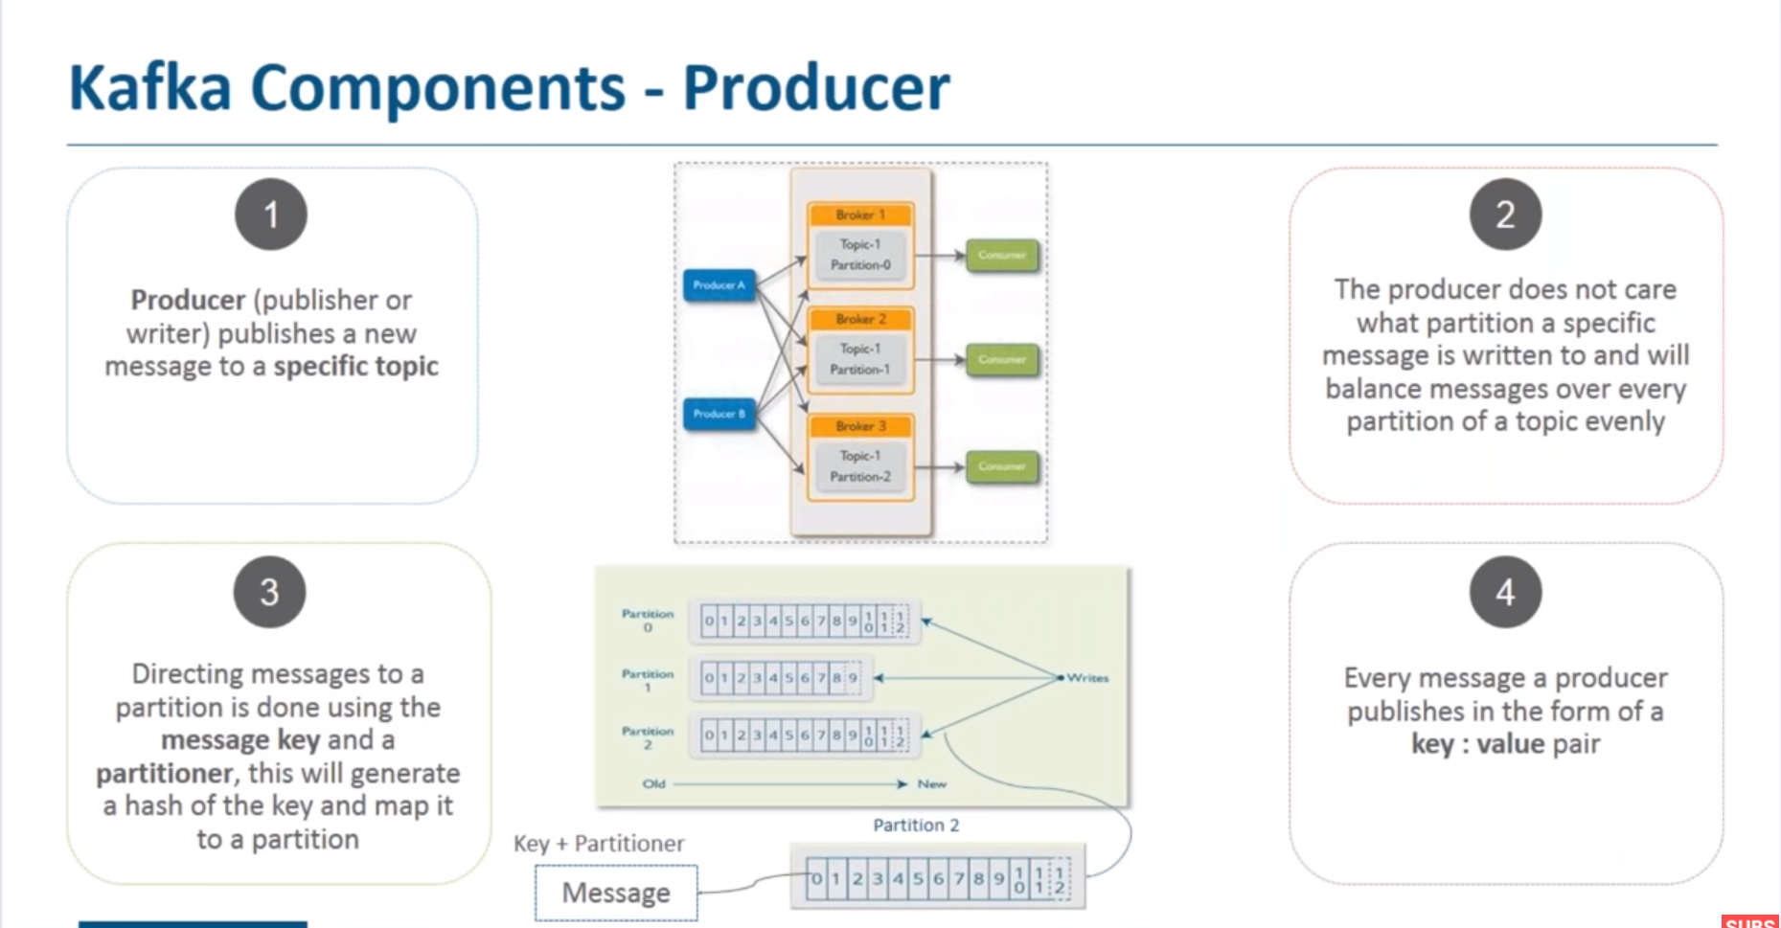

Slide 14
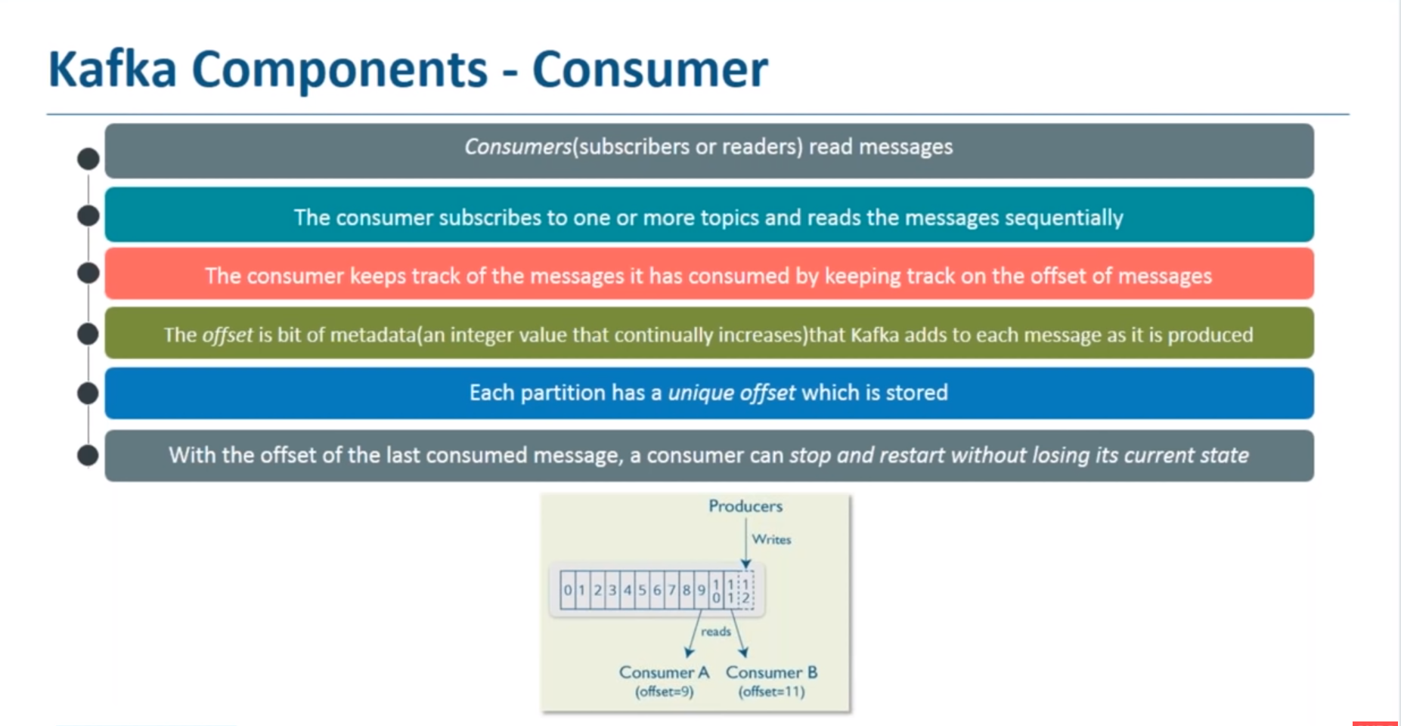

Slide 15
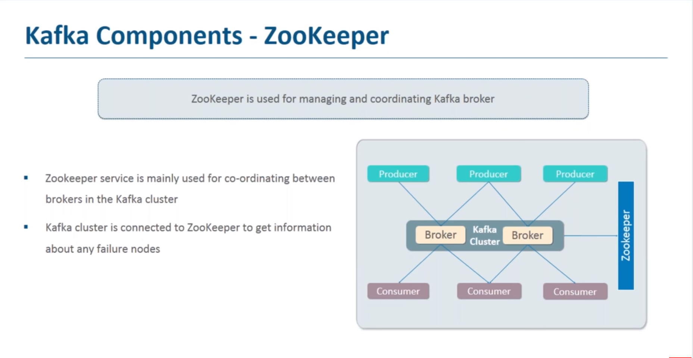

Slide 16
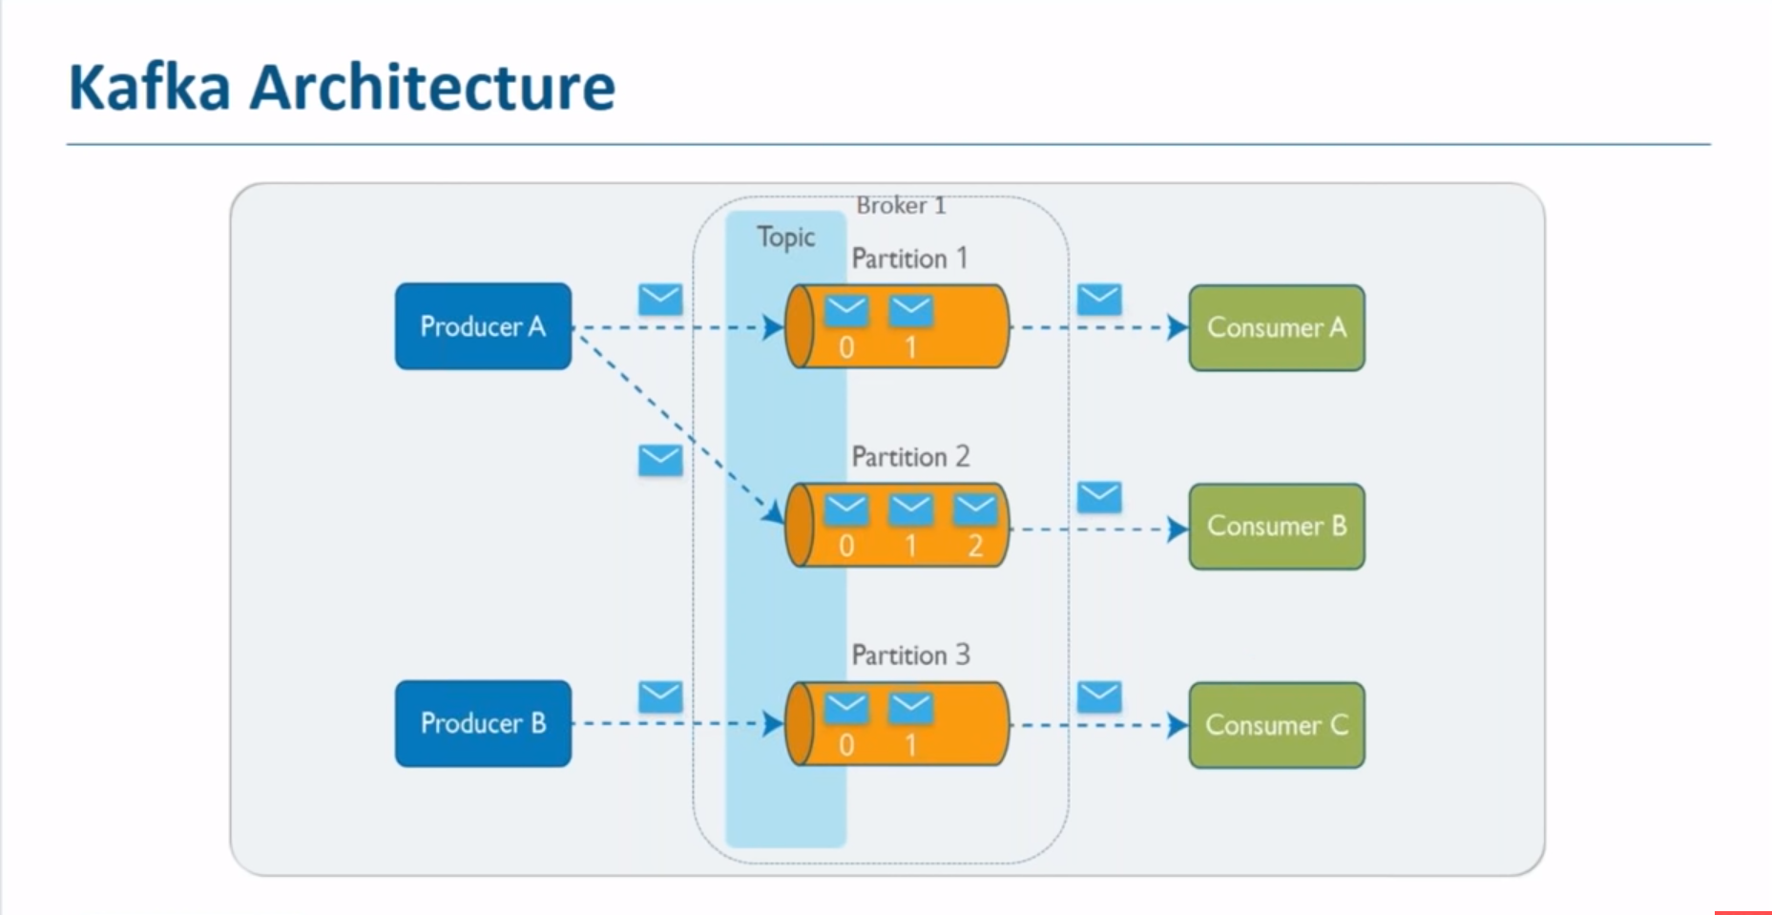

Slide 17
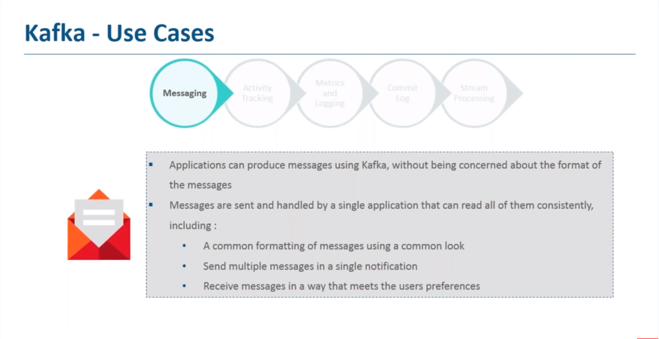

Slide 18
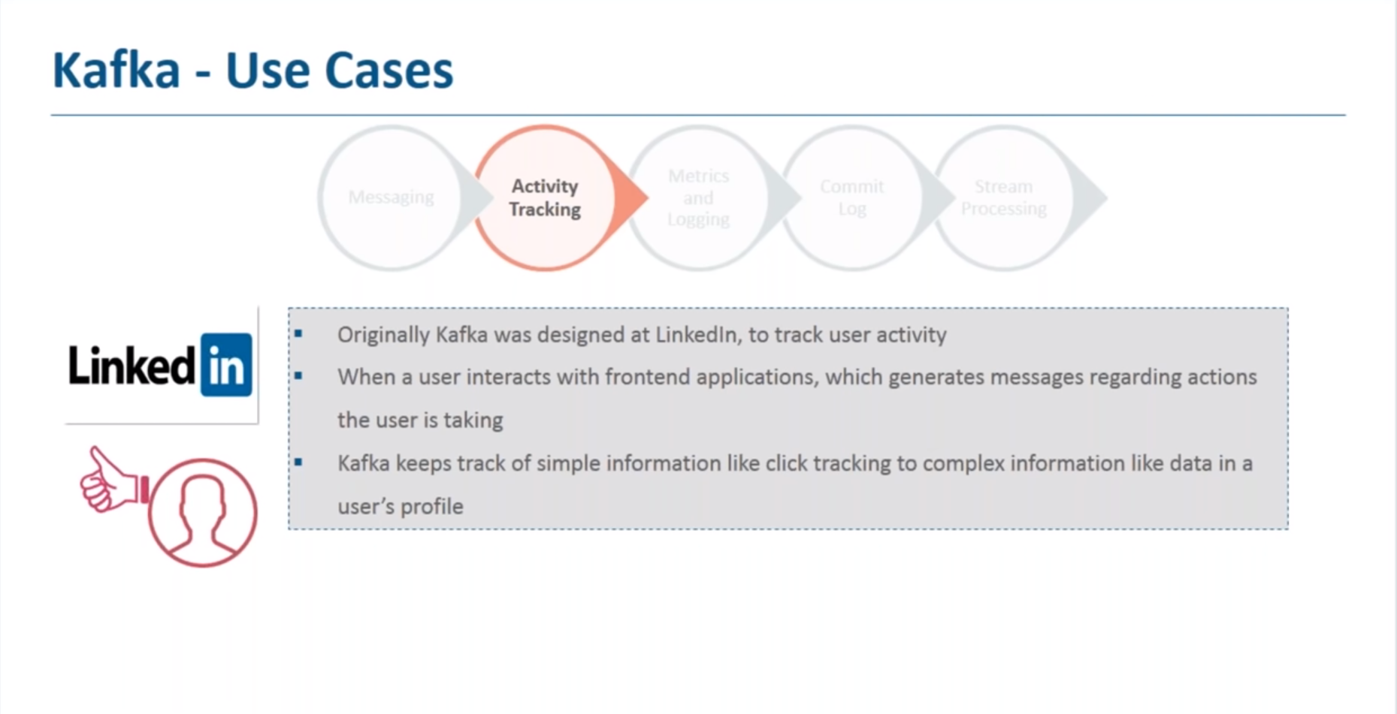

Slide 19
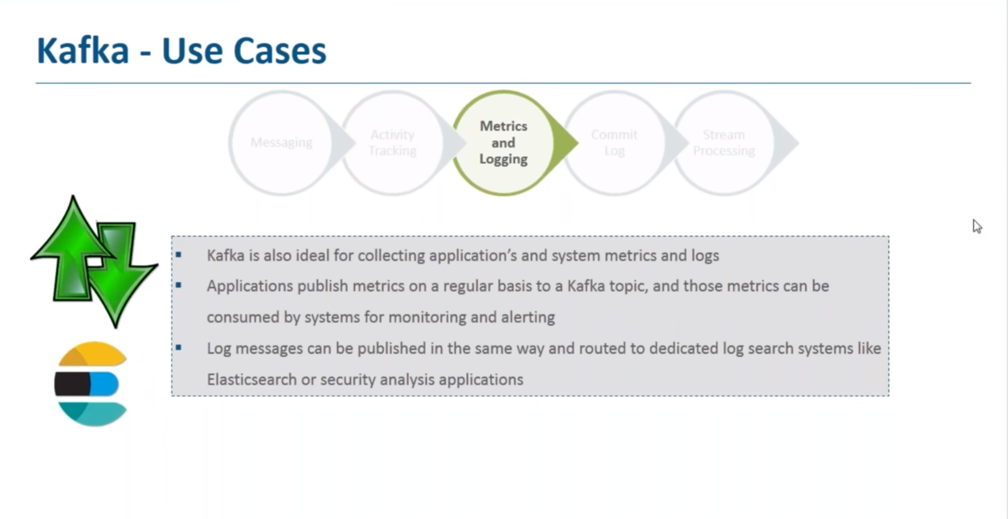

Slide 20
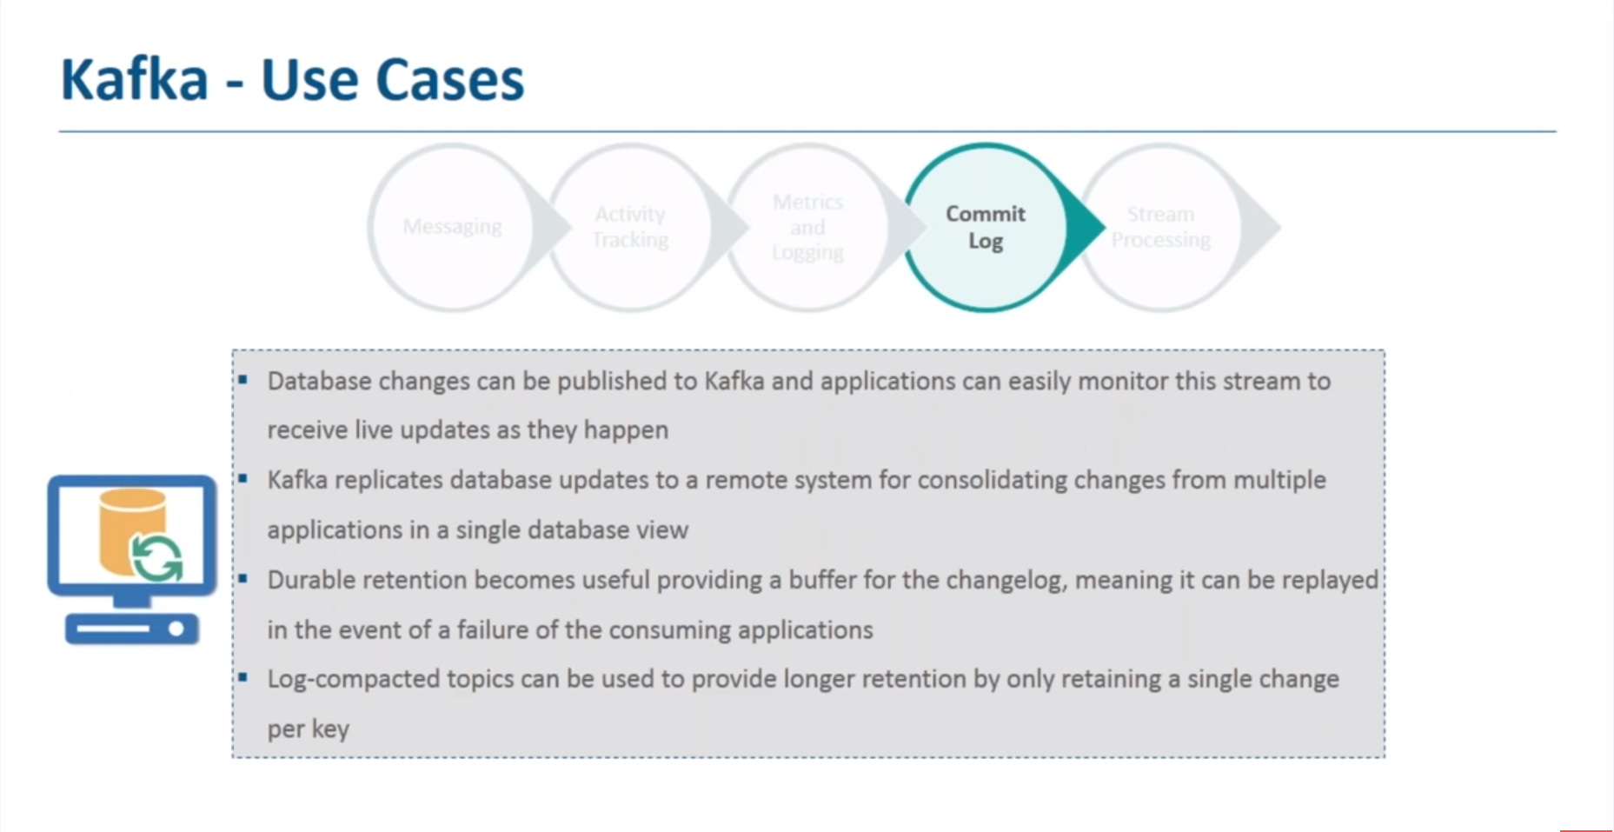

Slide 21
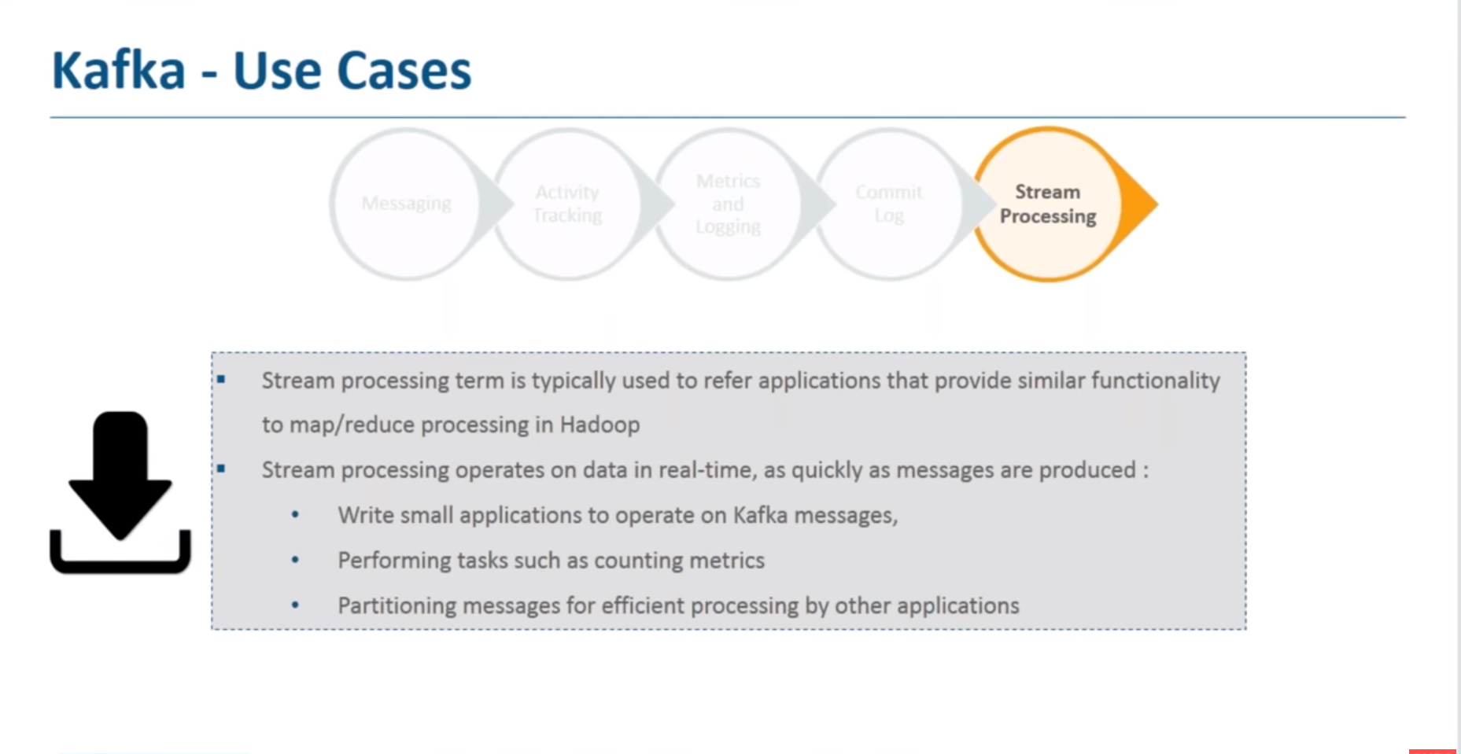

Slide 22
Kafka vs RabbitMQ
High Availability
Both solutions are highly available, but Kafka took that a step further, by using Zookeeper to manage the state of the cluster, and this leader is also highly available and can be distributed, think on it like they have a guard over a guard.
Performance
It requires less hardware, this can lead to high throughput: several millions of messages in a second, with just a tiny number of nodes. RabbitMQ also can process a million messages in a second but requires 30+ nodes.
Kafka scales nicely up to 100,000 msg/sec even on a single server. RabbitMQ scales nicely about 20,000 msg/sec on a single server.

Slide 23
Kafka vs RabbitMQ
Replication
Kafka has replicated the broker by design, and if the master broker is down, automatically all the work is passed to another one which has a full replica of the died one, no message lost. In RabbitMQ queues aren’t automatically replicable, this need to be configured.
Message lifetime
Because Kafka is a log, messages are always there, you can control this by defining a message retention policy. RabbitMQ is a queue, messages removed once consumed and acknowledgment arrived.

Slide 24
Quickstart
Step 1: Download the code
Download the 2.2.0 release and un-tar it.
tar -xzf kafka_2.12-2.2.0.tg
cd kafka_2.12-2.2.0
Step 2: Start the server
Start the zookeeper
> bin/zookeeper-server-start.sh config/zookeeper.properties
Start the kafka server
> bin/kafka-server-start.sh config/server.properties

Slide 25
Step 3: Create a topic
Let's create a topic named "test" with a single partition and only one replica:
> bin/kafka-topics.sh --create --bootstrap-server localhost:9092 --replication-factor 1 --partitions 1 --topic test
We can now see that topic if we run the list topic command:
> bin/kafka-topics.sh --list --bootstrap-server localhost:9092
Step 4: Send some messages
Run the producer and then type a few messages into the console to send to the server.
> bin/kafka-console-producer.sh --broker-list localhost:9092 --topic test
This is a message
This is another message
Step 5: Start a consumer
> bin/kafka-console-consumer.sh --bootstrap-server localhost:9092 --topic test --from-beginning
This is a message
This is another message

